Slide 1


Project Cost Management

Slide 2
What is Cost and Project Cost Management?
Cost is a resource sacrificed or fore-gone to achieve a specific objective or something given up in exchange
Costs are usually measured in monetary units like birr, dollar, etc
Project cost management includes the processes required to ensure that the project is completed within an approved budget
Project managers must make sure their projects are well defined, have accurate time and cost estimates and have a realistic budget that they were involved in approval.
2

Slide 3
The Importance of Project Cost Management
Software projects have a poor track record for meeting budget goals.
The CHAOS studies found the average cost overrun (the additional percentage or dollar amount by which actual costs exceed estimates) ranged from 180% in 1994 to 43% in 2002; other studies found overruns to be 33-34%
3

Slide 4
Reasons for Cost Overruns
Not emphasizing the importance of realistic project cost estimates from the outset.
Many of the original cost estimates for IT projects are low to begin with and based on very unclear project requirements
Many software professionals think preparing cost estimates is a job for accountants when in fact it is a very demanding and important skill that project managers need to acquire.
Many software projects involve new technology or business processes which involve untested products and inherent risks.
4

Slide 5
Project Cost Management Processes
Resource planning: determining what resources and quantities of them should be used.
Cost estimating: developing an estimate of the costs and resources needed to complete a project.
Cost budgeting: allocating the overall cost estimate to individual work items to establish a baseline for measuring performance.
Cost control: controlling changes to the project budget.
5

Slide 6
Basic Principles of Cost Management
Life cycle costing is estimating the cost of a project over its entire life.
Cash flow analysis is determining the estimated annual costs and benefits for a project.
Sunk cost are retrospective (past) costs that have already been incurred and cannot be recovered
Sunk costs should not be a criteria in project selection
6

Slide 7
Cost of Software Defects
Phase of Software Development | Relative Cost to Repair Defects
Requirements and Analysis | 1🞩
Coding and Unit Test | 5🞩
Integration and System Test | 10🞩
Beta Test | 15🞩
Post-Product Release | 30🞩
NB: 🞩 is a normalized unit of cost and can be expressed in dollars, person-hours, et.
It is much more cost-effective to spend money on defining user requirements and doing early testing on IT projects than to wait for problems to appear after implementation
If it would cost $1,000 to repair a software defect in the requirements and analysis phase but it would cost $30,000 to fix it in the post-product release phase
7

Slide 8
Resource Planning
The nature of the project and the organization will affect resource planning
Some questions to consider:
How difficult will it be to do specific tasks on the project?
Is there anything unique in this project’s scope
statement that will affect resources?
What is the organization’s history in doing similar tasks?
Does the organization have or can it acquire the people, equipment, and materials that are capable and available for performing the work?

Slide 9
Cost Estimating
An important output of project cost management is a cost estimate.
There are several types of cost estimates, and tools and techniques to help create them.
It is also important to develop a cost management plan that describes how cost variances will be managed on the project

Slide 10
Types of Cost Estimates
Type of Estimate | When Done | Why Done | How Accurate
Rough Order of Magnitude (ROM) | Very early in the project life cycle, often 3–5 years before project completion | Provides rough ballpark of cost for selection decisions | –25%, +75%
Budgetary | Early, 1–2 years out | Puts dollars in the budget plans | –10%, +25%
Definitive | Later in the project, < 1 year out | Provides details for purchases, estimate actual costs | –5%, +10%
A ROM estimate that actually cost $100,000 would range between $75,000 to $175,000.
A budgetary estimate that actually costs $100,000 would range between $90,000 to $125,000.
A definitive estimate that actually costs $ 100,000 would rang between $95,000 to $110,000.

Slide 11
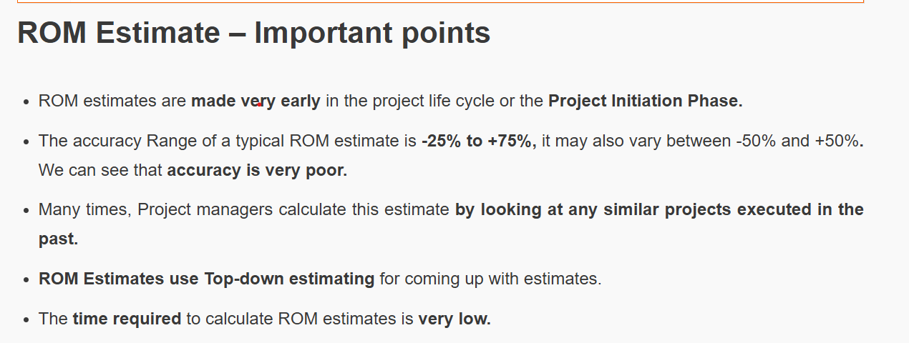
vv

Slide 12
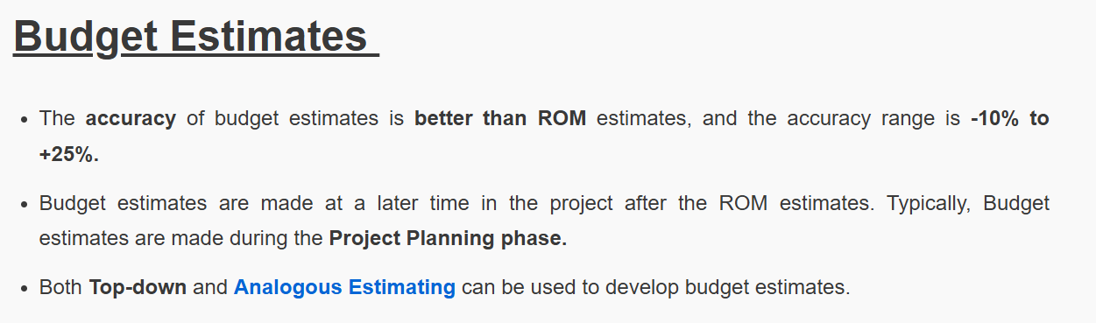

Slide 13
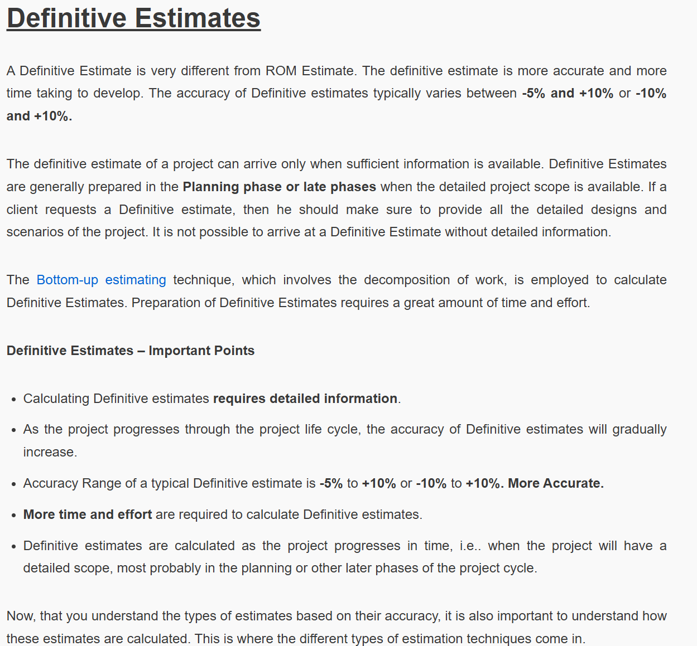

Slide 14
Cost Estimation Tools and Techniques
3 basic tools and techniques for cost estimates:
Analogous or top-down: use the actual cost of a previous, similar project as the basis for the new estimate
Bottom-up: estimate individual work items and sum them to get a total estimate
Parametric: use project characteristics in a mathematical model to estimate costs

Slide 15
Typical Problems with Cost Estimates
Developing an estimate for a large software project is a complex task requiring a significant amount of effort. Remember that estimates are done at various stages of the project
Many people doing estimates have little experience doing them. Try to provide training and mentoring.
People have a bias toward underestimation. Review estimates and ask important questions to make sure estimates are not biased
Management wants a number for a bid, not a real estimate. Project managers must negotiate with project sponsors to create realistic cost estimates

Slide 16
Cost Budgeting
Cost budget involves allocating the project cost estimate to individual work items and providing a cost baseline
For example, in the Business Systems Replacement project, there was a total purchased costs estimate for FY97 of $600,000 and another $1.2 million for Information Services and Technology.

Slide 17
Cost Control
Project cost control includes:
monitoring cost performance
ensuring that only appropriate project changes are included in a revised cost baseline
informing project stakeholders of authorized changes to the project that will affect costs
Earned value management is an important tool for cost control.

Slide 18

Earned Value Management (EVM)

Slide 19
Earned Value Management (EVM)
EVM is a project performance measurement technique that integrates scope, time, and cost data
Given a baseline (original plan plus approved changes), you can determine how well the project is meeting its goals
You must enter actual information periodically to use EVM.

Slide 20
Earned Value Management
Earned V alue Analysis is an industry standard way to:
measure a project’s progress,
forecast its completion date and final cost, and
provide schedule and budget variances along the way.
By integrating three measurements, it provides consistent, numerical indicators with which you can evaluate and compare projects.

Slide 21

EMV enables
Knowing where you are on schedule?
Knowing where you are on budget?
Knowing where you are on work accomplished?

Slide 22
Earned Value Management Terms
Planned value (PV), formerly called the budgeted cost of work scheduled (BCWS), also called the budget, is that portion of the approved total cost estimate planned to be spent on an activity during a given period.
Actual cost (AC), formerly called actual cost of work performed (ACWP), is the total of direct and indirect costs incurred in accomplishing work on an activity during a given period.
Earned value (EV), formerly called the budgeted cost of work performed (BCWP), is the percentage of work actually completed multiplied by the planned value

Slide 23
Earned Value Formulas
TERM | FORMULA
Earned Value | EV = BAC 🞩 Percent Completed
Cost Variance | CV = EV – AC
Schedule Variance | SV = EV – PV
Cost Performance Index | CPI = EV/AC
Schedule Performance Index | SPI = EV/PV
To estimate what it will cost to complete a project or how long it will take based on performance to date, divide the budgeted cost or time by the appropriate index.

Slide 24
Rules of Thumb for EVA Numbers
Negative numbers for cost and schedule variance indicate problems in those areas.
The project is costing more than planned or taking longer than planned
Zero variance shows that the project is running according to the plan
CPI and SPI > 1.0 indicate exceptional performance
CPI and SPI < 1.0 indicate poor performance
If CPI or SPI = 1, it shows that the project is performing according to its plan

Slide 25
Example
Suppose you have a software project which is planned to be completed in 9 months with a budget of Birr 900,000.
After a month,10% of the project is completed at a total expense of Birr 100,000, but the planned completion was 15%.
Given:
Budget At Complete (BAC) = Birr 900,000
AC = Birr 100,000

Slide 26
Compute
PV
EV
CV - interpretation
SV - interpretation
CPI - interpretation
SPI - interpretation
Forecast -Budget at complete
Forecast - Time at complete
Overall project’s traffic light status

Slide 27
…solution
a) Planned Value = Planned Completion (%) * BAC
= 15% * Birr 900,000
= Birr 135,000
= Percent Completed (%) * BAC
= 10% * Birr 900,000
= Birr 90,000
b) Earned Value

Slide 28


…continued
CV = EV – AC
= 90,000 – 100,000
= -10,000
SV = EV – PV
= 90,000 – 135,000
= - 45,000
The project is costing more than planned because CV is less than zero.
The project is taking longer than planned because SV is less than zero.

Slide 29
…continued
CPI= EV / AC
= 90,000 / 100,000
= 0.90
SPI= EV/PV
= 90,000 / 135,000
= 0.67
It shows Poor Performance because CPI and SPI are less than one.

Slide 30
Forecasting Cost
If the project continues at the current performance, what is the true cost of the project?
Estimate at Complete
= Budget at Complete (BAC) / CPI
= Birr 900,000 / 0.90 = Birr 1,000,000
At the end of the project, the total project cost will be Birr 1,000,000

Slide 31
Forecasting Time
If the project continues at the current performance, what is the true time of the project?
Estimate at Complete
= Original Time Estimate / SPI
= 9 months / 0.67 = 13.43 months
The project will be completed by the end of
13.34 months.

Slide 32

Establish Ranges to Guide Traffic Light Status
Traffic light status is useful in conveying overall project’s
status with one color
Establish objective SPI and CPI ranges to determine the true project color.
Average of CPI & SPI i.e. (CPI+SPI)/2
Green Yellow Red
[1.0 - 0.95]
[0.94 - 0.85]
[0.84 - 0]
Good
Warning
Bad

Slide 33
Therefore, for the above example, overall
project’s traffic light status is
= (CPI+SPI)/2
= (0.90+0.67)/2
= 0.78
Bad

Slide 34


